Slide 1
The anatomy of the chest wall and the physiology of breathing

Slide 2
Learning objectives
To be able to:
  Identify the bony structures of the chest wall
  Identify the muscular and soft tissue structures of the chest wall
  Identify the nervous system involved in breathing
  Understand and explain the mechanics of breathing :
    Inspiration
    Expiration
    Control of breathing
  Explain the relevance to physiotherapy

Slide 3
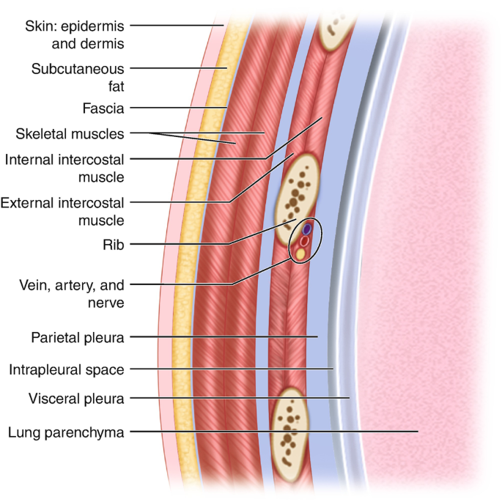
The chest wall : Overview
The chest wall:
  10 layers
  Epidermis, dermis, superficial and deep fascia
  Extrinsic and intrinsic muscles
  Ribs, Sternum and spine
  Endothoracic fascia
  Parietal pleura

Slide 4
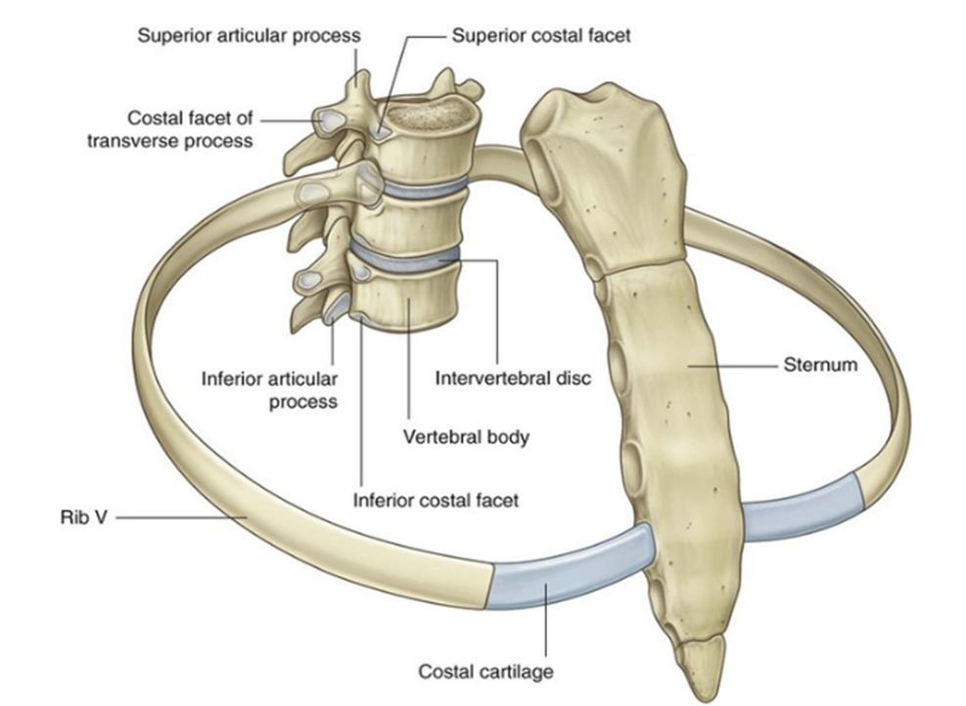
Bony Structures of the Chest wall
The structure of the rib cage :
    Thoracic spine T1to T12
    Clavicle ( collarbone)
    Ribs 1 to 12
      True ribs 1-7
      False ribs 8-10
      Floating ribs 11-12
    Costal Cartilage
    Sternum
    Manubrium
    Xiphoid process

Slide 5
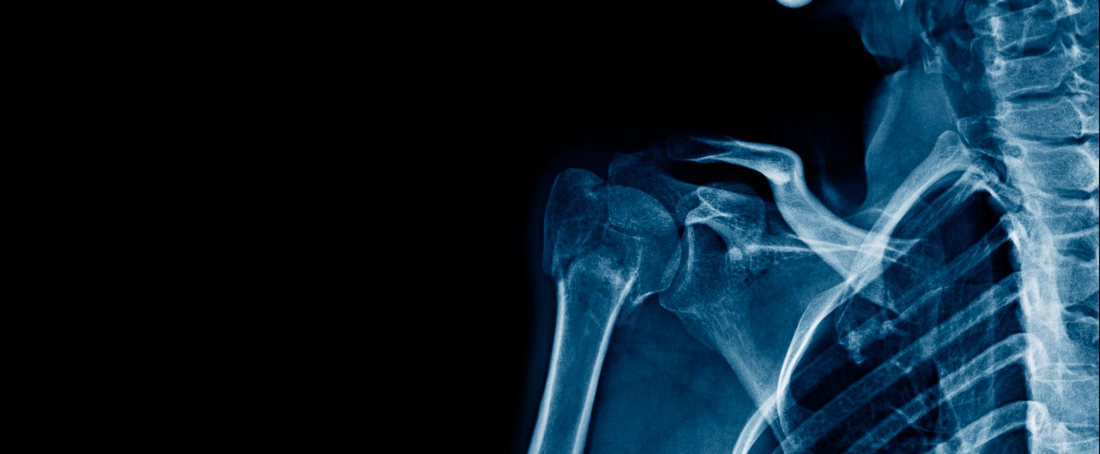
Thoracic Cage

Slide 6
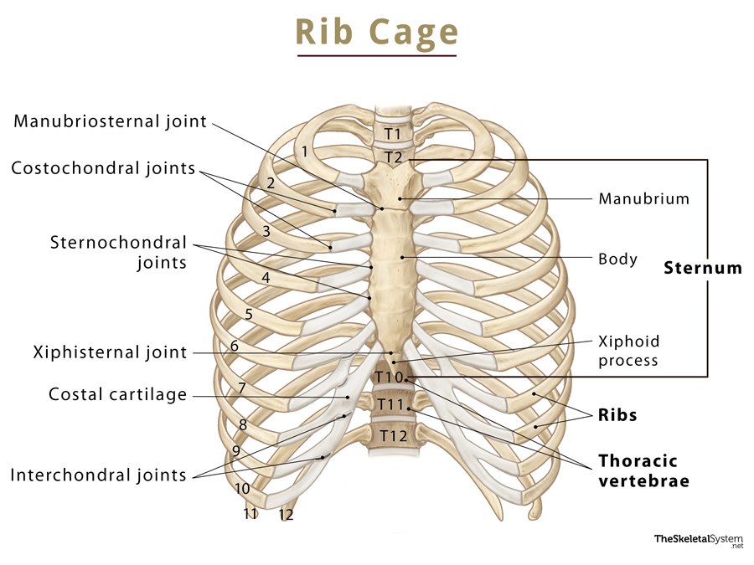
Thoracic cage
Clavicle :
  1st costal cartilage attach to the manubrium
2nd costal cartilage :
  Attach to the Sternal angle

Slide 7
Thoracic cage
True ribs: 1-7th
  lies deep to the clavicle ( difficult to palpate)
  Attached to sternum ( via costochondral joints
False ribs: 8-10th
  Attached anteriorly only (via costochondral joints)
  Form interchondral + chondrocostal joints
Free floating ribs : 11th-12th ribs
  Only attach posteriorly

Slide 8
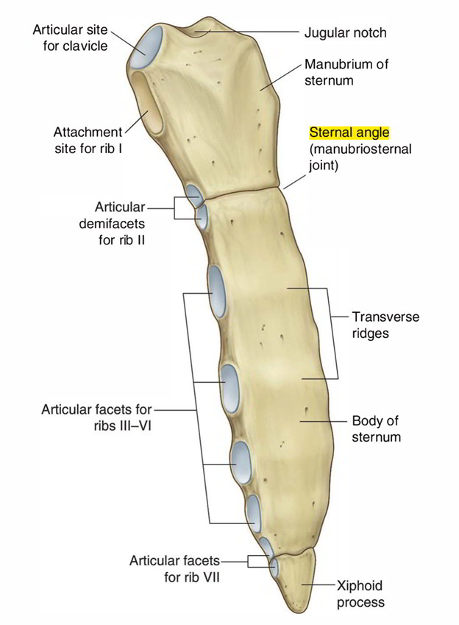
Thoracic cage
Sternal angle : acts as a hinge enabling movement
  Ossifies with age
Synovial Joints:
  Freely mobile
  Ribs, costal cartilage, vertebrae and sternum : synovial
Primary Cartilaginous Joints:
  Bones connected by hyaline cartilage
  1st costal cartilage and manubrium

Slide 9
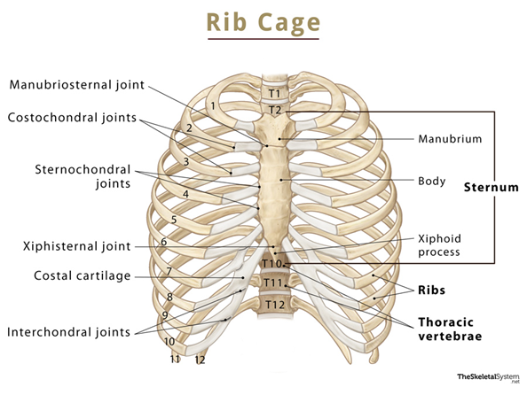
Sternocostal joints
Key facts about the sternocostal joints
Type | Sternocondral Joint 1: Primary cartilaginous joint (synchondrosis) Sternochondral Joints 2-7: Synovial Planar Joints: Nonaxial, uniplanar
Articular surfaces | Sternal ends of costal cartilages of the true ribs, costal notches on sternum
Ligaments | Radiate sternochondral, xiphichondral and intra-articular sternochondral ligaments.
Innervation | Intercostal nerve
Blood Supply | Internal Thoracic Artery
Movements | Sternochondral Joint 1: almost no movement Sternochondral Joint 2-7: translation, mainly superinferioraly

Slide 10
Manubriosternal joint
Key facts about the manubriosternal joint
Type | Secondary Cartilaginous joint (Symphysis)
Articular surfaces | Inferior margin of the manubrium of sternum, articular disc, superior margin of sternal body.
Ligaments | Manubriosternal Ligament
Movements | Angulation, anteroposterior displacement

Slide 11
Xiphisternal joint
Key facts about the xiphisternal joint
Type | Secondary Cartilaginous joint (Symphysis)
Articular surfaces | Superior margin of the xiphoid process, articular disc, inferior margin of sternal body.
Ligaments | Anterior and posterior Xiphichondral Ligaments
Movements | No movement

Slide 12
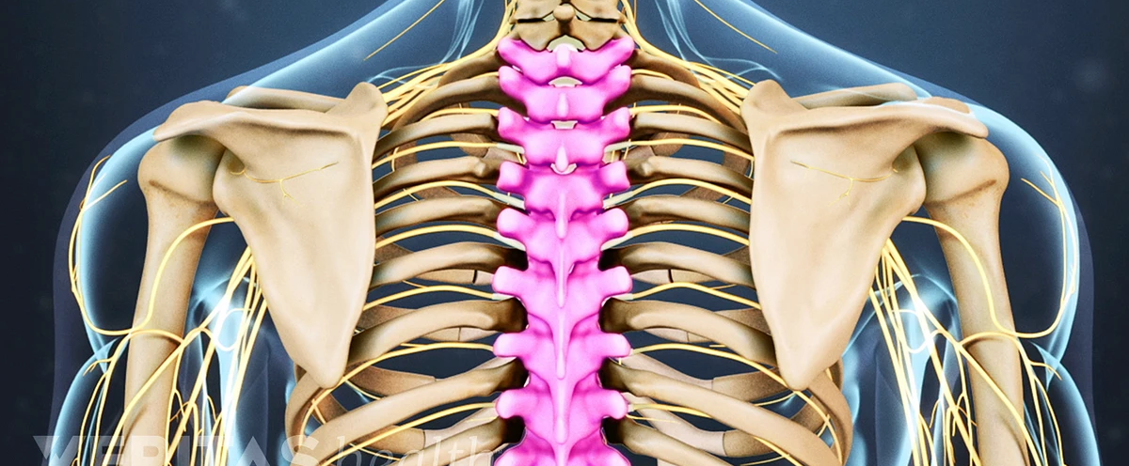
Thoracic Spine

Slide 13
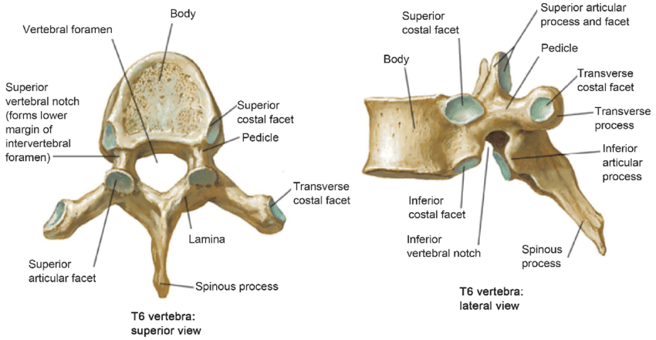
T2-T9

Slide 14
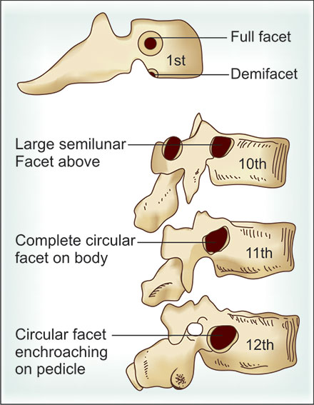
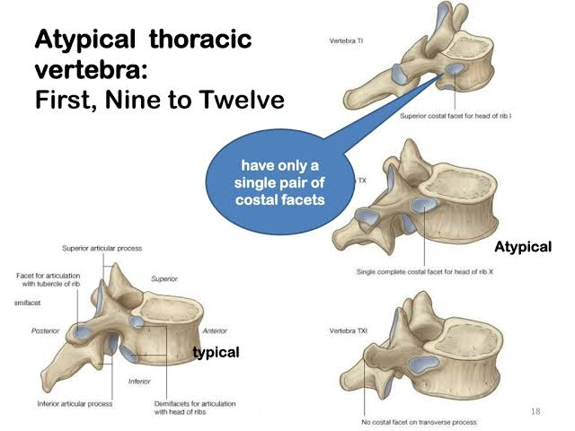
T1, T10-T12

Slide 15
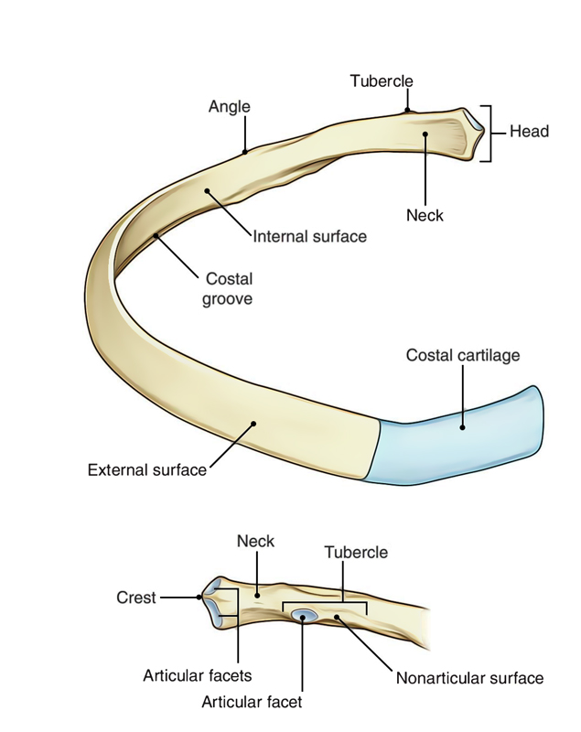
Ribs: Rib 3 - 10
Typical Ribs
Two articular facets:
  Superior demi facet: articulates with numerically corresponding body of thoracic vertebrae eg T3
  Inferior demi facet
Tubercle:
  Articulates with numerically corresponding transverse process of the vertebrae
  Non-articulating part: attachment for lateral costotransverse ligament
Angle tear shaped shaft

Slide 16
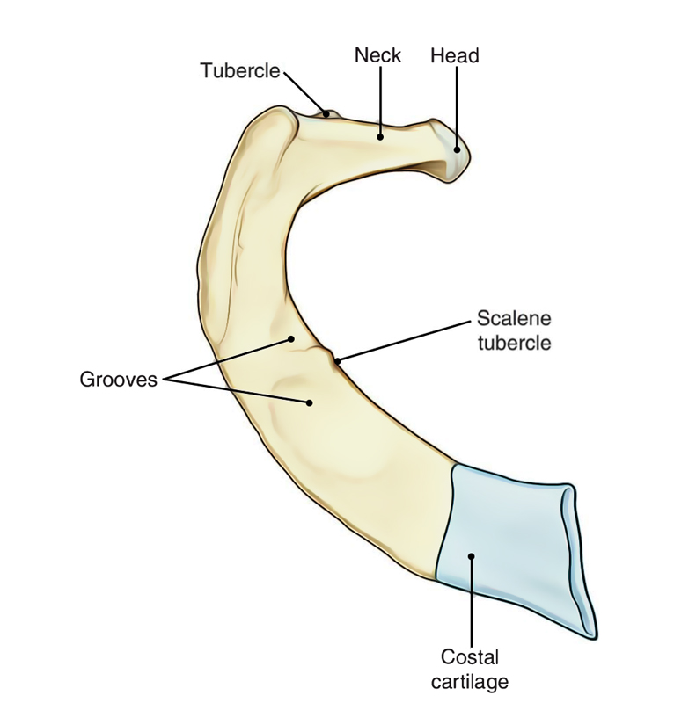
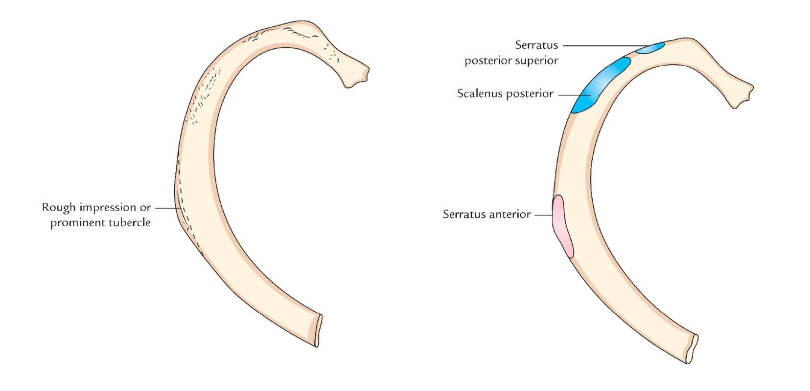
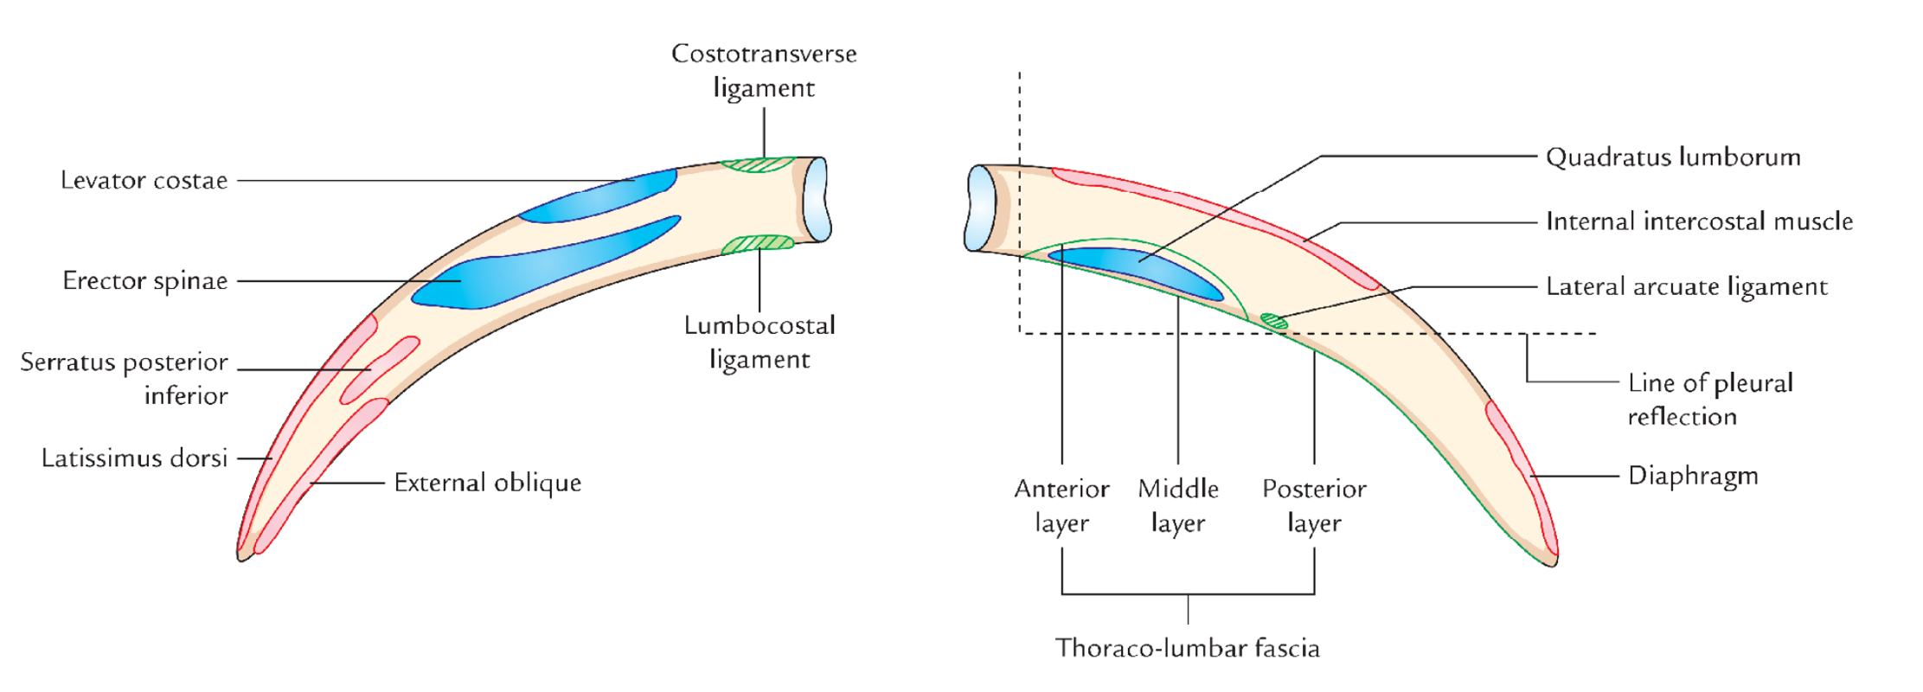
Ribs: 1st, 2nd , 11th and 12th (sometimes 10th)
The first rib
The second rib
The eleventh and twelfth rib
Short, strong, flat and very curved
Has a tubercle for scalenus anterior
Single facet on the rib head
Grooves for subclavian vessels.
Tubercle for scalenus posterior
Tubercle for serratus anterior
Do not have tubercles and do not attach to anything anteriorly.
Only have a single facet on their head.
The Tenth Rib
Only sometime atypical as may only articulate with the 10th vertebrae.

Slide 17
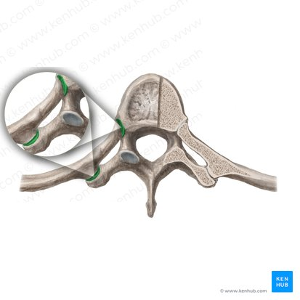
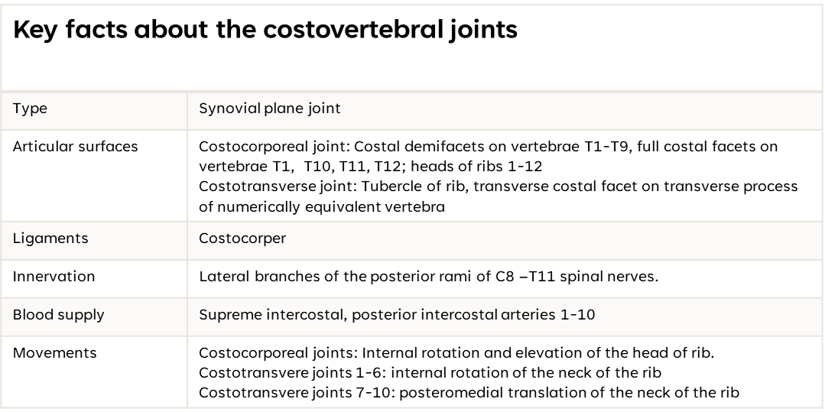
Costovetebral Joints and facet joints

Slide 18
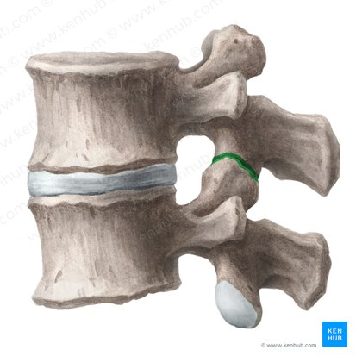
Joints of the vertebral bodies
Key facts about the Facet joints/ zygopophaseal joint
Type | Synovial plane joint
Articular surfaces | Inferior and superior articular facets
Ligaments | Ligamenta flava, interspinous ligaments, supraspinous ligament and intertransverse ligaments
Innervation | Lateral branches of the posterior rami of C8 –T11 spinal nerves.
Blood supply | Supreme intercostal, posterior intercostal arteries 1-10
Movements | In the thoracic region of the spine, the superior articular facets largely project posteriorly whereas inferior facets are mainly anteriorly positioned. The joint planes are therefore vertically placed, restricting flexion and extension, but allow for rotation movement

Slide 19
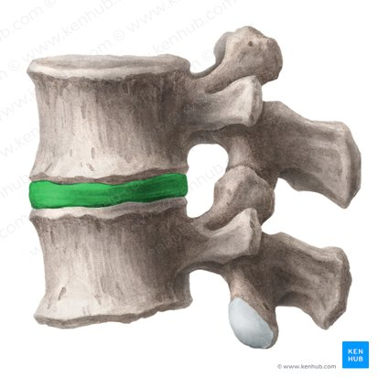
Joints of the vertebral bodies
Key facts about the intervertebral discs
Type | Secondary Cartilaginous joint
Articular surfaces | Adjacent vertebral bodies
Ligaments | Ligamenta flava, interspinous ligaments, supraspinous ligament and intertransverse ligaments- also act as a ligament in itself.
Innervation | Sinovertebral nerves
Blood supply | Osmotic supply
Movements | Flexion, extension, lateral flexion and rotation.

Slide 20
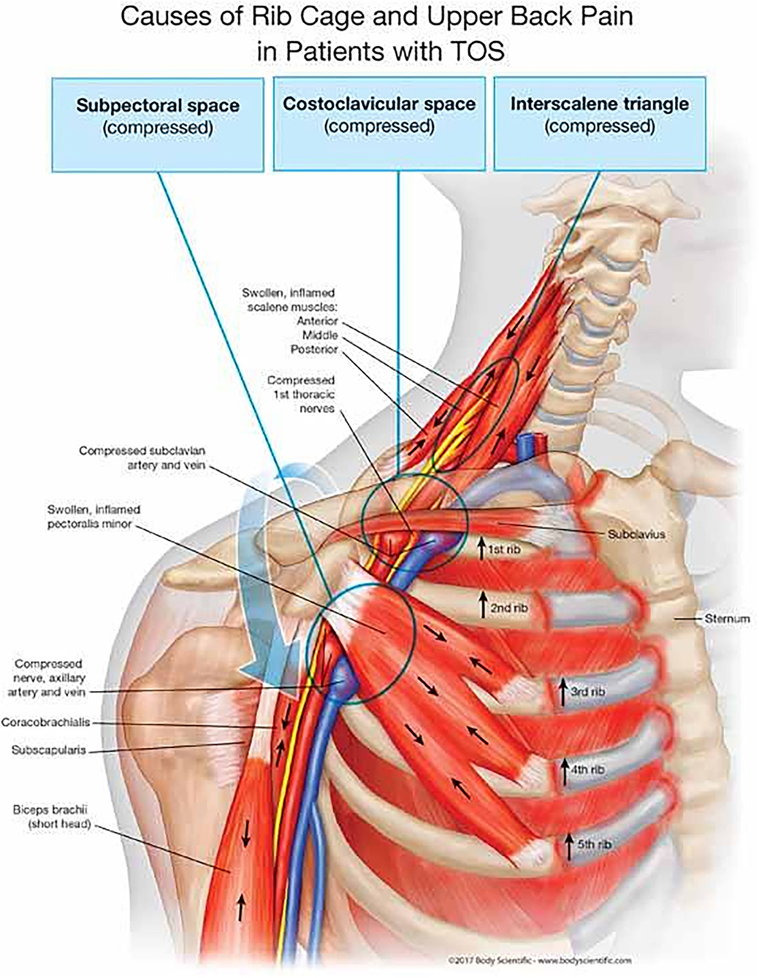
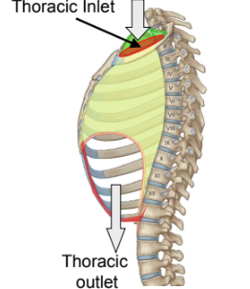
Boundaries of the Thoracic cavity

Slide 21
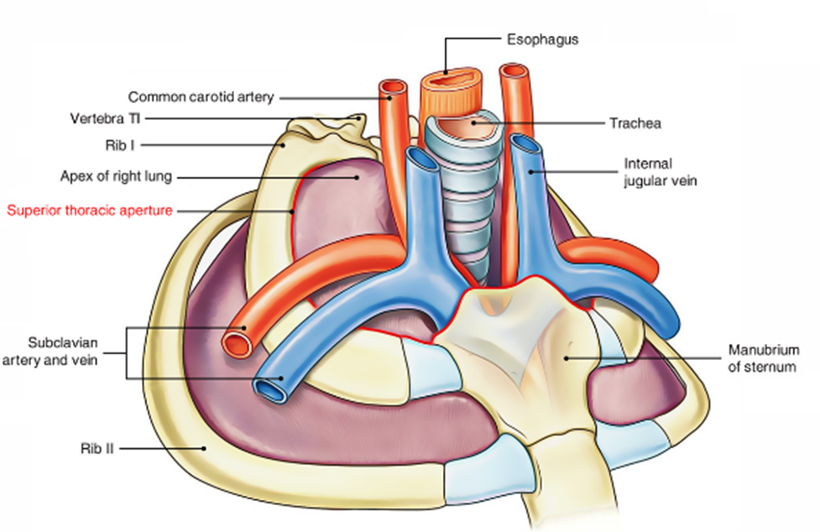
Thoracic outlet
Transmits structures passing from chest into neck and upper limb
Suprapleural membrane
Tough fascia
Attaches around bony-cartilaginous margins
Preventing lung expansion in upward direction
Continuous with endothoracic fascia (lines entire chest cavity)
Trachea, oesophagus, blood vessels pierce fascia
Thoracic Outlet Syndrome (TOS):
Compression of neurovasculature in the inlet
Apical lung cancer, of clavicle, fractures, extra cervical rib ( <1%)
Pain, weakness, numbness, tingling, swelling, coldness in upper limb

Slide 22
Muscles of respiration
Inspiration at rest
Expiration at rest
Intercostal muscles
Diaphragm
Relaxation of the intercostal muscles and diaphragm.
Inspiration during distress/exercise
Expiration during distress/exercise
Scalene
Sternoclemastoid
Serratus Anterior
Pectoralis Major
Pectoralis minor
Trapezius
Latissimus dorsi
Erector spinae
Iliocostalis lumborum
Quadratus lumborum
Rectus Abdominus
Transverse Abdominus
External Oblique
Internal Oblique
Latissimus Dorsi

Slide 23
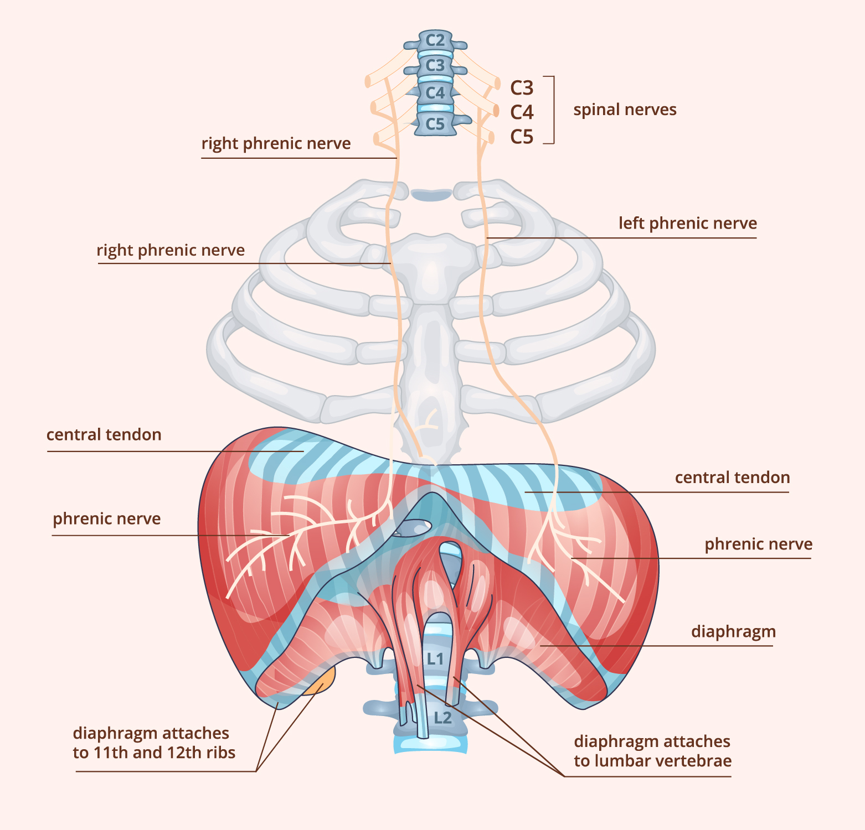
Inspiratory muscles at rest
Key facts about the Diaphragm
Origin | Posterior aspect of the Xiphoid process Internal surfaces of the lower costal cartilage and ribs 7-12 Medial and lateral arcuate ligaments, bodies of vertebrae L1-L3 and anterioir longitudonal ligament.
Insertion | Central tendon of diaphragm
Openings | Aortic hiatus (aorta, azygos vein, thoracic duct), esophageal hiatus (esophagus, vagus nerve), caval foramen (inferior vena cava) Mnemonic: I 8 10 EGGS AT 12 Greater, lesser, least splanchnic nerves, superior epigastric vessels
Innervation | Phrenic nerve C3-C5, periphery sensory nerve 6th to the 11th intercostal nerve. Mnemonic: C3 4 and 5 keeps the diaphragm alive.
Blood supply | Subcostal and lowest 5 intercostal arteries, inferior phrenic arteries, superior phrenic arteries
Movements | Depresses costal cartilage, depresses inferiorly to allow for inspiration when contracts, when the diaphragm relaxes ascends superiorly.

Slide 24
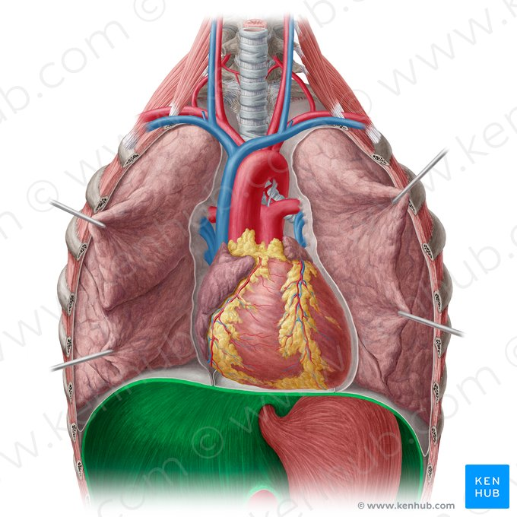
Inspiratory muscles at rest
Opening in the diaphragm: Mnemmonic I 8 10 eggs AT 12
Inferior Vena Cava (IVC) at T8
Esophagus and vagus at T10
Aorta, Azygos vein, Thoracic duct at T12
Notes:
Skeletal muscles are composed of fibres of different types, each type being identified by the isoform of myosin heavy chain which is expressed as slow 1, fast 2A, fast 2X, and fast 2B. Slow fibres are resistant to fatigue due to their highly oxidative metabolism whereas 2X and 2B fibres are easily fatiguable and fast 2A fibres exhibit intermediate fatigue resistance. Slow fibres and fast fibres are present in equal proportions in the adult human diaphragm while intercostal muscles contain a higher proportion of fast fibres. A small fibre size, abundance of capillaries, and a high aerobic oxidative enzyme activity are typical features of diaphragm fibres and give them the resistance to fatigue required by their continuous activity. Because of their fibre composition, intercostal muscles are less resistant to fatigue. The structural and functional characteristics of respiratory muscle fibres are not fixed, however, and can be modified in response to several physiological and pathological conditions such as training (adaptation to changes in respiratory load), adaptation to hypoxia, age related changes, and changes associated with respiratory diseases. The properties of respiratory muscle fibres can also be modified by pharmacological agents such as β₂ agonists and corticosteroids used for the treatment of respiratory diseases.

Slide 25
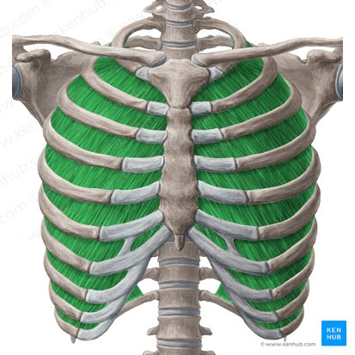
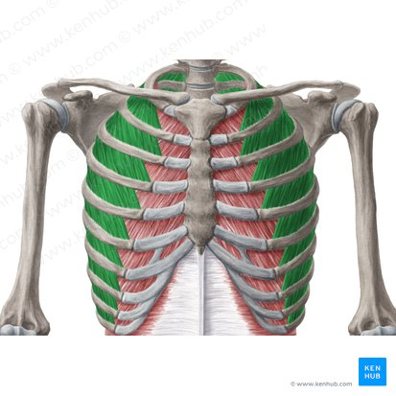
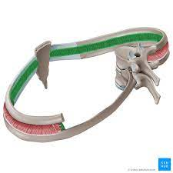
Inspiratory muscles at rest
Intercostal muscles:
- external
- internal
- Innermost
Notes:
Fatigue quicker

Slide 26
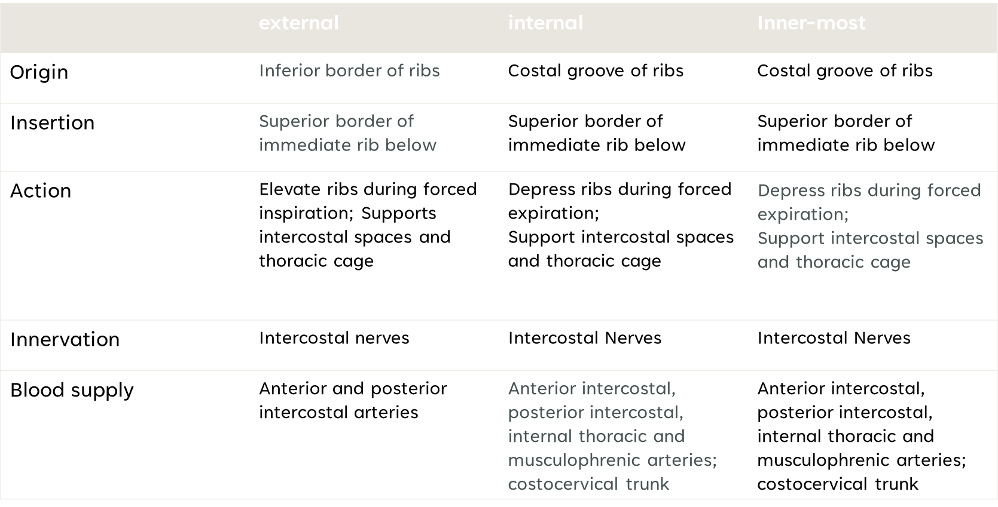
Key Facts on these muscles

Slide 27
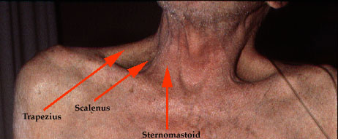
Accessory muscles

Slide 28
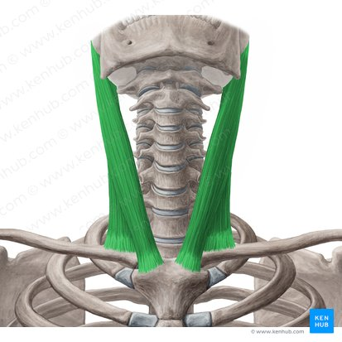
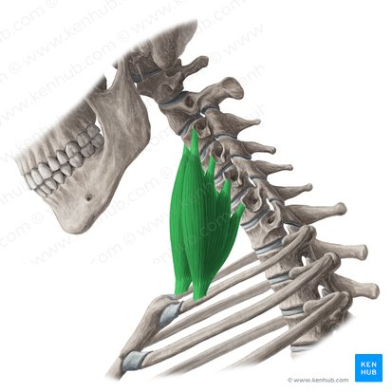
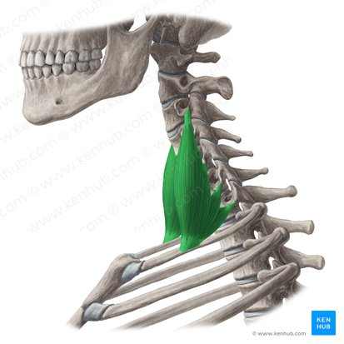
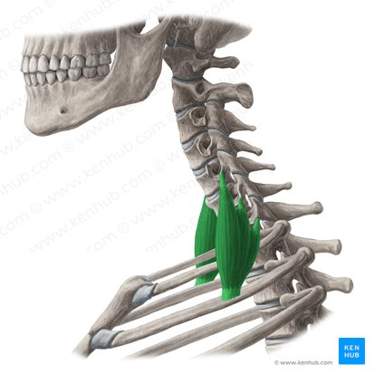
Accessory inspiratory muscles of the neck
Key facts:
Origins | Sternal head: superior part of anterior surface of manubrium sterni Clavicular head: superior surface of medial third of the clavicle
Insertions | Lateral surface of mastoid process of the temporal bone, Lateral half of superior nuchal line of the occipital bone
Innervation | Accessory nerve (CN XI), branches of cervical plexus (C2-C3)
Blood supply | Superior thyroid artery
Functions | Unilateral contraction: cervical spine: neck ipsilateral flexion, neck contralateral rotation Bilateral contraction: atlantooccipital joint/ superior cervical spine: head/neck extension; Inferior cervical vertebrae: neck flexion; sternoclavicular joint: elevation of clavicle and manubrium of sternum
Key facts about scalene muscles
Anterior scalene muscle | Origin: anterior tubercle of transverse processes of vertebrae C3-C6 Insertion: scalene tubercle of rib 1, superior border of rib 1 (anterior to subclavian groove) Innervation: anterior rami of spinal nerves C4-C6 Blood supply: ascending cervical branch of the inferior thyroid artery. Function: - bilateral contraction - neck flexion - unilateral contraction - neck lateral flexion (ipsilateral), neck rotation (contralateral), elevates rib 1
Middle scalene muscle | Origin: transverse processes of C1/C2 -> C7 (specifically posterior tubercles of transverse processes of vertebrae in C3-C7) Insertion: superior border of rib 1 (posterior to subclavian groove) Innervation: anterior rami of spinal nerves C3-C8 Blood supply: ascending cervical branch of the inferior thyroid artery Function: neck lateral flexion, elevates rib 1
Posterior scalene muscle | Origin: posterior tubercles of transverse processes of vertebrae C4-C6/C5-C7 Insertion: external surface of rib 2 Innervation: anterior rami of spinal nerves C6-C8 Blood supply: ascending cervical branch of the inferior thyroid artery; superficial cervical artery Function: neck lateral flexion, Elevates rib 2

Slide 29
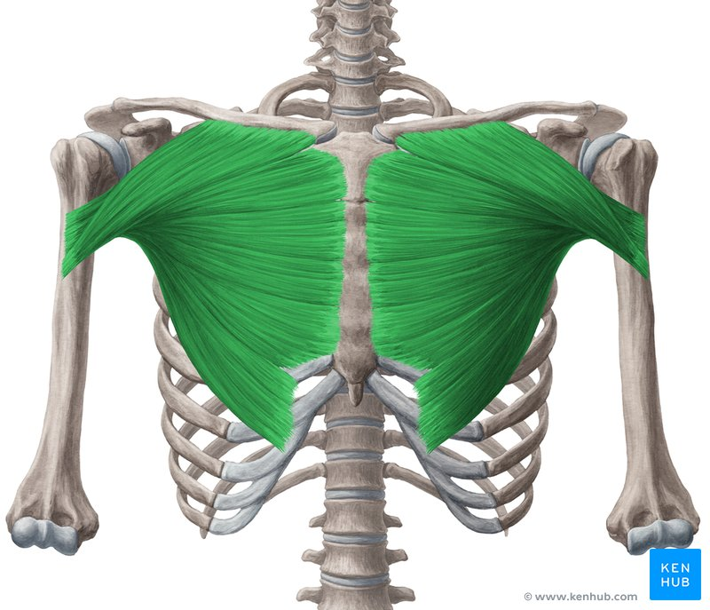
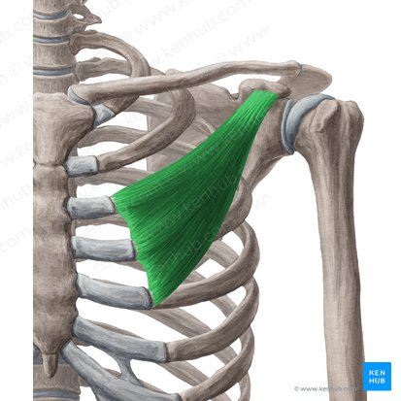
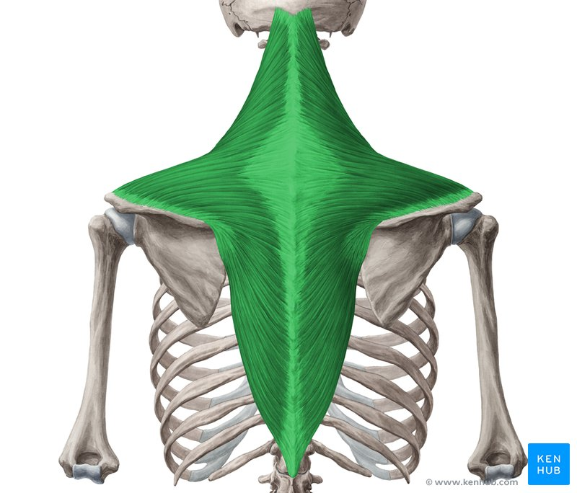
Accessory muscles of the shoulder girdle
Key facts: Pec Major
Origins | Sternal head: superior part of anterior surface of manubrium sterni Clavicular head: superior surface of medial third of the clavicle
Insertions | Lateral surface of mastoid process of the temporal bone, Lateral half of superior nuchal line of the occipital bone
Innervation | Accessory nerve (CN XI), branches of cervical plexus (C2-C3)
Blood supply | Superior thyroid artery
Functions | Unilateral contraction: cervical spine: neck ipsilateral flexion, neck contralateral rotation Bilateral contraction: atlantooccipital joint/ superior cervical spine: head/neck extension; Inferior cervical vertebrae: neck flexion; sternoclavicular joint: elevation of clavicle and manubrium of sternum
Key fact Pec Minor
Origin | Anterior surface, costal cartilages of ribs 3-5
Insertion | Medial border and coracoid process of scapula
Innervation | Medial and lateral pectoral nerves (C5-T1)
Blood supply | Thoracoacromial a. (pectoral and deltoid branches), superior thoracic a., lateral thoracic a.
Function | Scapulothoracic joint: draws scapula anteroinferiorly, stabilizes scapula on thoracic wall
Key facts about the trapezius muscle
Origin | Descending part (superior fibers): medial third of the superior nuchal line, external occipital protuberance, nuchal ligament Transverse part (middle fibers): spinous processes and supraspinous ligaments of vertebrae T1-T4 (or C7-T3) Ascending part (inferior fibers): spinous processes and supraspinous ligaments of vertebrae T4-T12
Insertion | Descending part (superior fibers): lateral third of clavicle Transverse part (middle fibers): medial acromial margin, superior crest of spine of scapula Ascending part (inferior fibers): lateral apex of the medial end of scapular spine
Innervation | Motor: accessory nerve (CN XI) Motor/Sensory: anterior rami of spinal nerves C3-C4 (via cervical plexus)
 | Descending part (superior fibers) - Scapulothoracic joint: draws scapula superomedially - Atlantooccipital joint: extension of head and neck, lateral flexion of head and neck (ipsilateral) - Altantoaxial joint: rotation of head (contralateral) Transverse part (middle fibers) - Scapulothoracic joint: draws scapula medially Ascending part (inferior fibers) - Scapulothoracic joint: Draws scapula inferomedially
Blood supply | Occipital artery (descending part), superficial or transverse cervical artery (transverse part), dorsal scapular artery (ascending part)

Slide 30
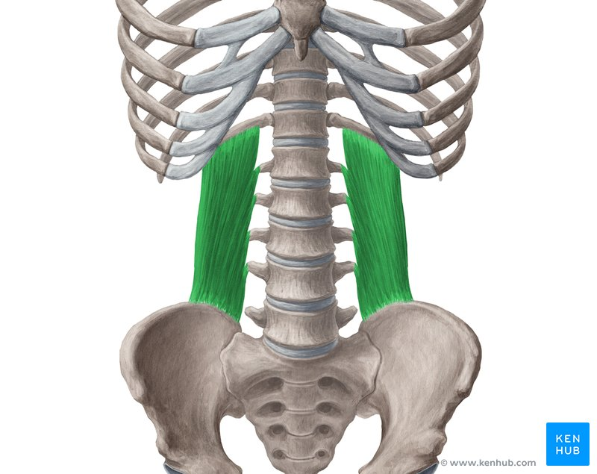
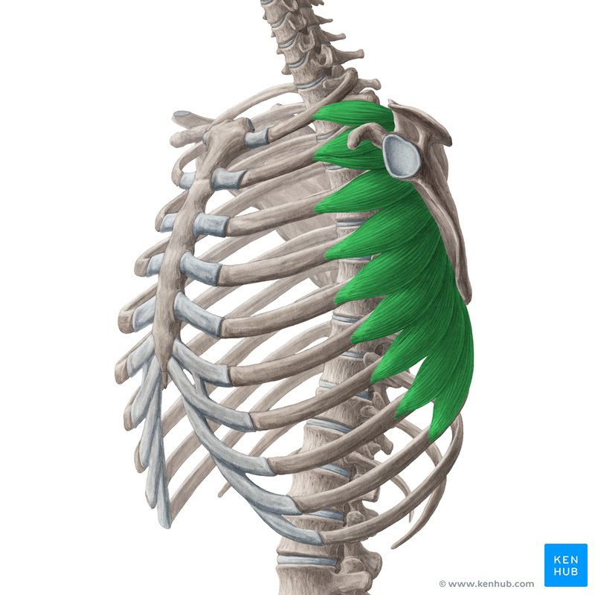
Accessory inspiratory muscles of the shoulder girdle and back.
Key facts about the quadratus lumborum
Origin | Iliac crest, iliolumbar ligament
Insertion | Inferior border of rib 12, transverse processes of vertebrae L1-L4
Innervation | Subcostal nerve (T12), anterior rami of spinal nerves L1-L4
Blood supply | Lumbar, median sacral, iliolumbar and subcostal arteries
Function | Bilateral contraction - fixes Ribs 12 during inspiration, trunk extension Unilateral contraction - lateral flexion of trunk (ipsilateral)
Key facts about the serratus anterior muscleTable quiz
Origin | Superior part: Ribs 1-2, Intercostal fascia Middle part: Ribs-3-6 Inferior part: Ribs 7-8/9 (variably extends to rib 10 (+ external oblique muscle))
Insertion | Scapula (Superior part: Anterior surface of superior angle Middle part: Anterior surface of medial border Inferior part: Anterior surface of inferior angle and medial border)
Innervation | Long thoracic nerve (C5- C7) Mnemonics: 'SALT' (stands for serratus anterior - long thoracic) & 'C5, 6, 7 raise your arms to heaven!'
Blood supply | Superior and lateral thoracic arteries, thoracodorsal artery branches
Function | Scapulothoracic joint: Draws scapula anterolaterally, Suspends scapula on thoracic wall, Rotates scapula (draws inferiorly angle laterally)
Notes:
The study of respiratory muscles activation during respiratory muscle strength effort in adult females with chronic neck pain - PMC (nih.gov)

Slide 31
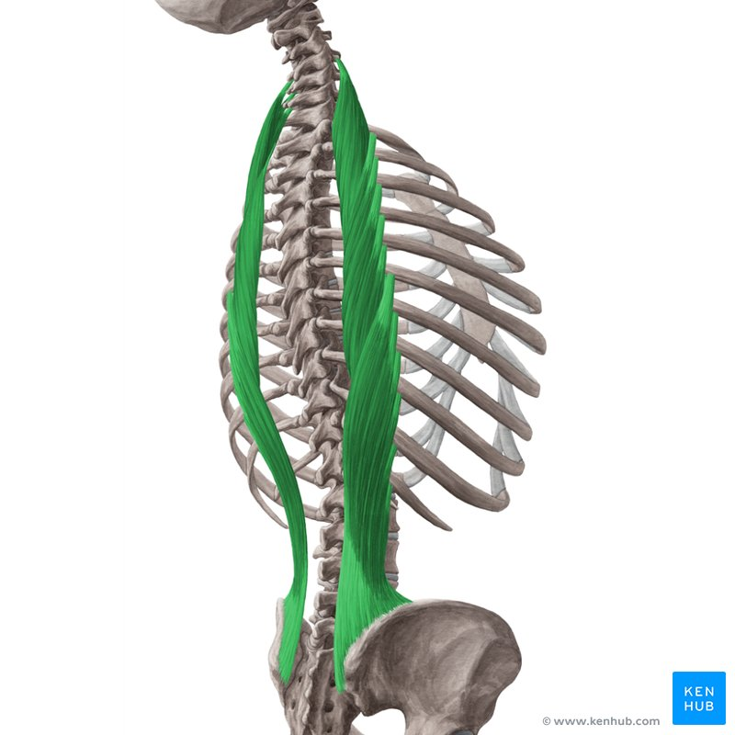
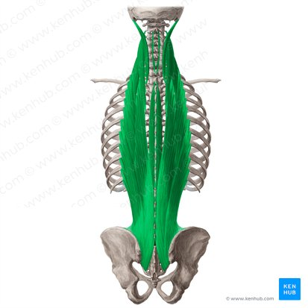
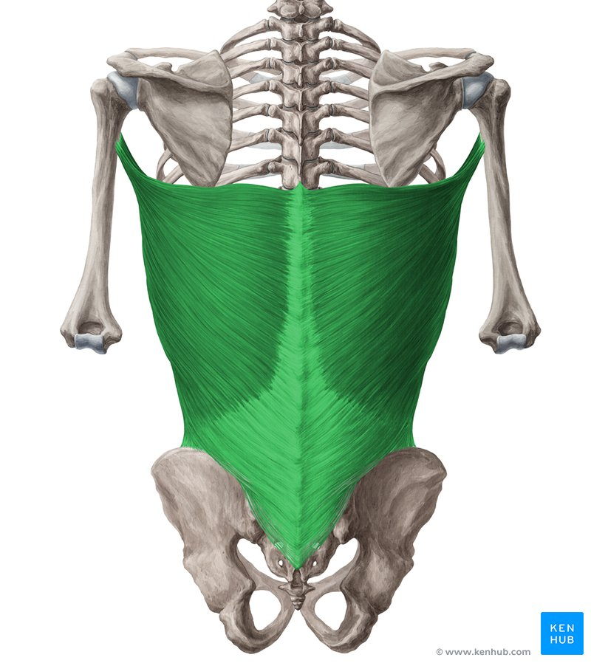
Accessory muscles of the back.
Key facts about the iliocostalis muscleTable quiz
Origin | Iliocostalis cervicis: Angle of ribs 3-6 Iliocostalis thoracis: Angle of ribs 7-12 Iliocostalis lumborum: Lateral crest of sacrum, medial end of iliac crest, thoracolumbar fascia
Insertion | Iliocostalis cervicis: Transverse processes of vertebrae C4-C6 Iliocostalis thoracis: Angles of ribs 1-6, transverse process of vertebra C7 Iliocostalis lumborum: Angle of ribs 5-12, transverse processes of vertebrae L1-L4 (+ Adjacent thoracolumbar fascia)
Action | Bilateral contraction: Extension of spine Unilateral contraction: Lateral flexion of spine (ipsilateral)
Innervation | Lateral branches of posterior rami of spinal nerves
Blood supply | Iliocostalis cervicis: occipital, deep cervical and vertebral arteries Iliocostalis thoracis: dorsal branches of posterior intercostal and subcostal arteries Iliocostalis lumborum: dorsal branches of lumbar and lateral sacral arteries
Key facts Erector Spinae
Definition | Three groups of deep muscles located on either side of the vertebral column
Function | Bilateral contraction - extension of spine Unilateral contraction - lateral flexion of spine (ipsilateral)
Key facts Latissimus Dorsi
Origin | Vertebral part: Spinous processes of vertebrae T7-T12, Thoracolumbar fascia Iliac part: Posterior third of crest of ilium Costal part: Ribs 9-12 Scapular part: Inferior angle of scapula
Insertion | Intertubercular sulcus of the humerus, between pectoralis major and teres major muscles Mnemonic: Lady between two majors (lady refers to latissimus dorsi)
Innervation | Thoracodorsal nerve (C6-C8)
Blood supply | Thoracodorsal artery, perforating arteries of the 9th-11th posterior intercostal arteries, and 1st-3rd lumbar arteries
Functions | Shoulder joint: Arm internal rotation, Arm adduction, Arm extension; Assists in respiration
Notes:
The study of respiratory muscles activation during respiratory muscle strength effort in adult females with chronic neck pain - PMC (nih.gov)

Slide 32
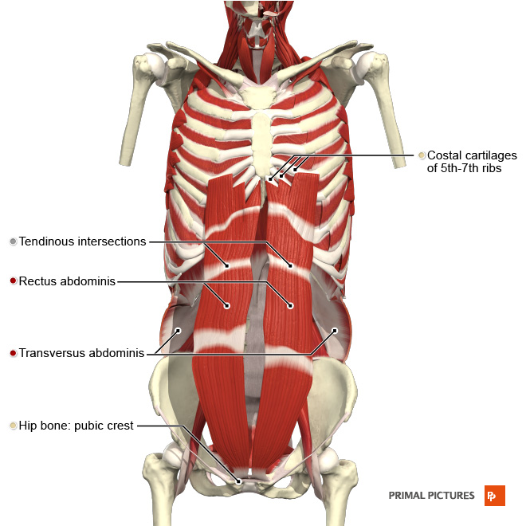
Expiratory muscles
Rectus Abdominus
Transverse abdominus
External Oblique
Internal Oblique
Latissimus Dorsi

Slide 33
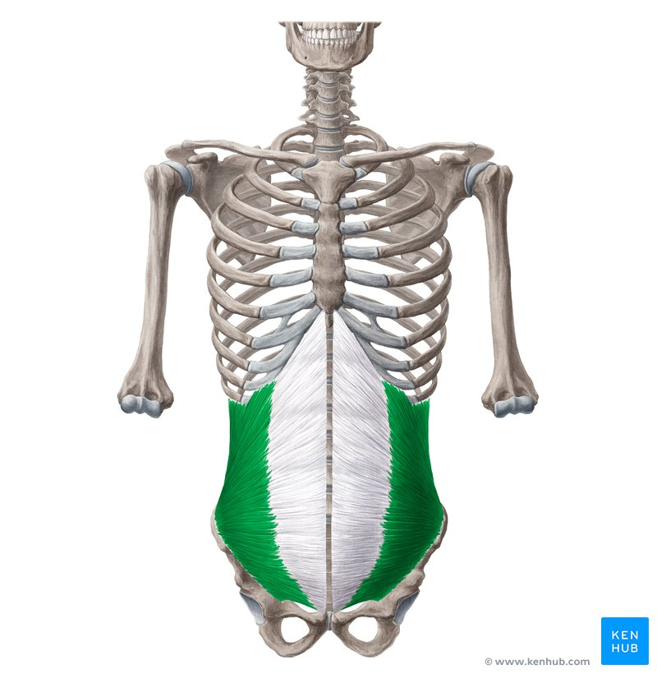
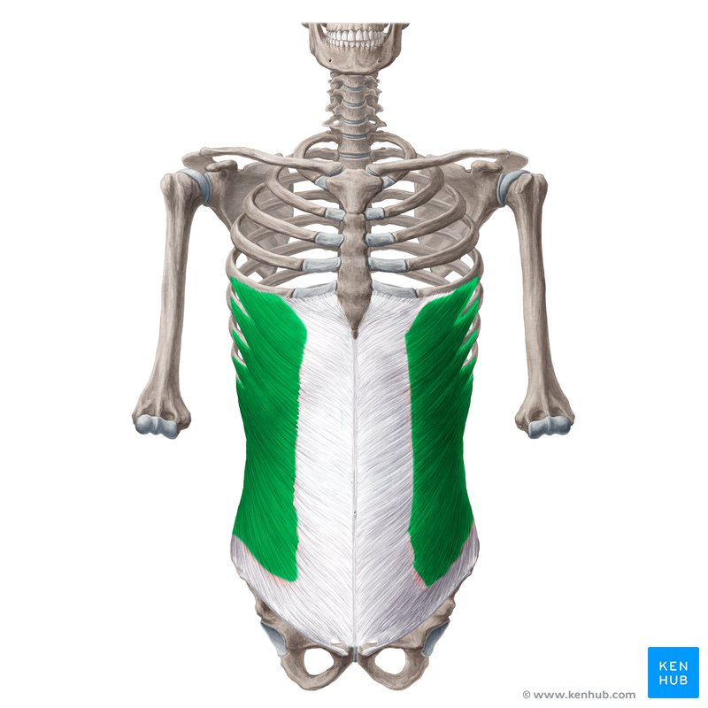
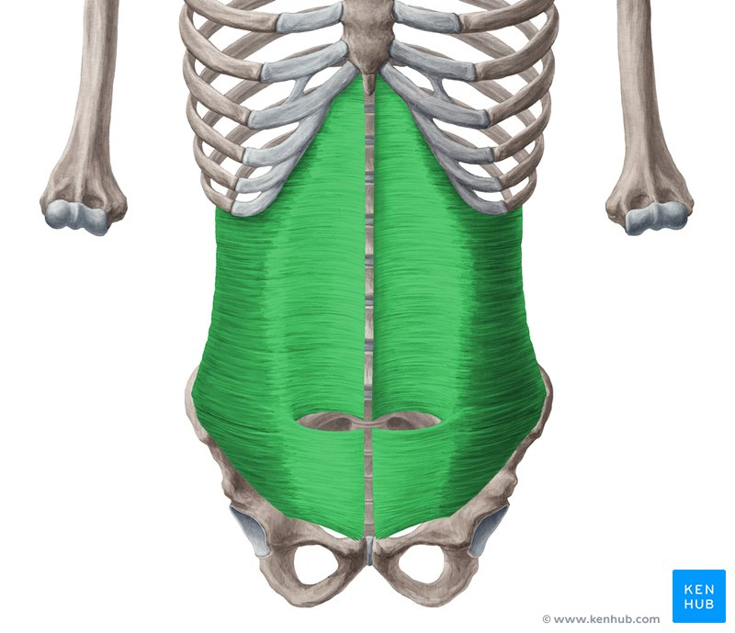
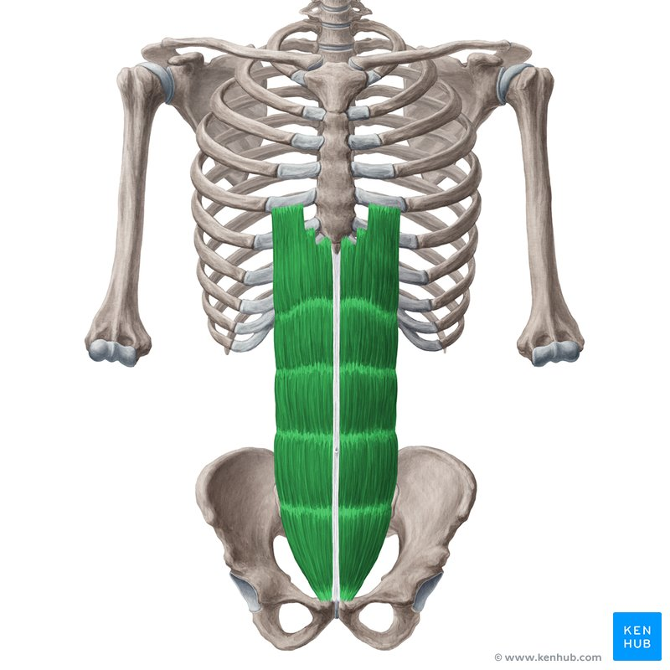
Expiratory muscles
Key facts about the transversus abdominis muscle
Origin | Internal surfaces of costal cartilages of ribs 7-12, thoracolumbar fascia, anterior two thirds of iliac crest, iliopectineal arch
Insertion | Linea alba, aponeurosis of internal abdominal oblique muscle; pubic crest, pectinal line of pubis
Action | Bilateral contraction - Compresses abdominal viscera, expiration Unilateral contraction - Trunk rotation (ipsilateral)
Innervation | Intercostal nerves (T7-T11), subcostal nerve (T12), iliohypogastric nerve (L1), ilioinguinal nerve (L1)
Blood supply | Lower posterior intercostal and subcostal arteries, superior and inferior epigastric arteries, superficial and deep circumflex arteries,posterior lumbar arteries
Key facts about the internal abdominal oblique
Origin | Anterior two-thirds of iliac crest, iliopectineal arch, thoracolumbar fascia
Insertion | Inferior borders of ribs 10-12, linea alba, pubic crest & pectin pubis (via conjoint tendon)
Action | Bilateral contraction - Trunk flexion, compresses abdominal viscera, expiration Unilateral contraction - Trunk lateral flexion (ipsilateral), trunk rotation (ipsilateral)
Innervation | Intercostal nerves (T7-T11), subcostal nerve (T12), iliohypogastric nerve (L1), ilioinguinal nerve (L1)
Blood supply | Lower posterior intercostal and subcostal arteries, superior and inferior epigastric arteries, superficial and deep circumflex arteries,posterior lumbar arteries
Key facts about the external abdominal oblique muscle
Origin | External surfaces of ribs 5-12
Insertion | Linea alba, pubic tubercle, anterior half of iliac crest
Action | Bilateral contraction - Trunk flexion, compresses abdominal viscera, expiration Unilateral contraction - Trunk lateral flexion (ipsilateral), trunk rotation (contralateral)
Innervation | Motor: Intercostal nerves (T7- T11), Subcostal nerve (T12) Sensory: Iliohypogastric nerve (L1)
Blood supply | Lower posterior intercostal arteries, subcostal artery, deep circumflex iliac artery
Key facts about the rectus abdominis muscle
Origin | Pubic symphysis, pubic crest
Insertion | Xiphoid process, costal cartilages of ribs 5-7
Innervation | Intercostal nerves (T7-T11), subcostal nerve (T12)
Blood supply | Inferior epigastric and superior epigastric arteries; contributions from posterior intercostal, subcostal and deep circumflex arteries
Function | Trunk flexion, compresses abdominal viscera, expiration

Slide 34
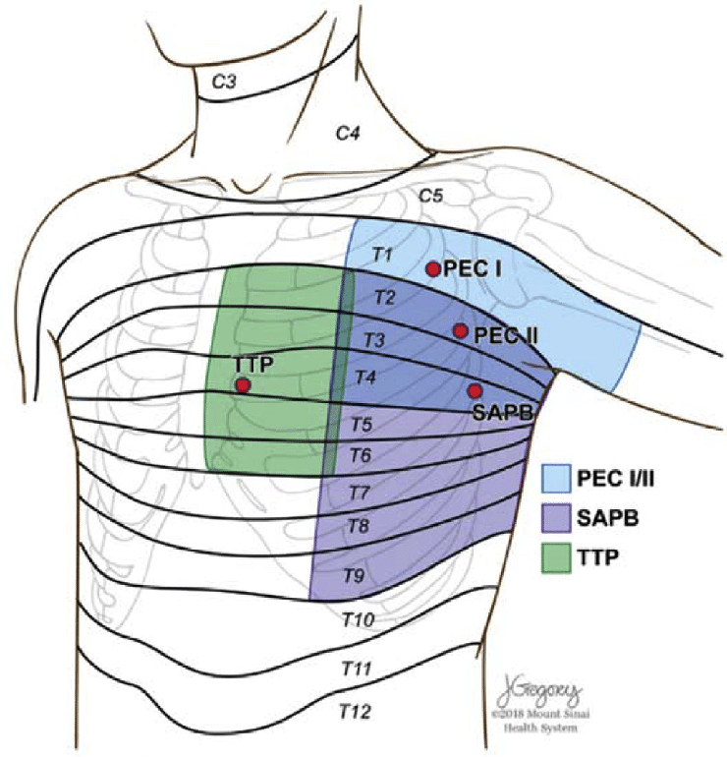
Neurology of the chest wall

Slide 35
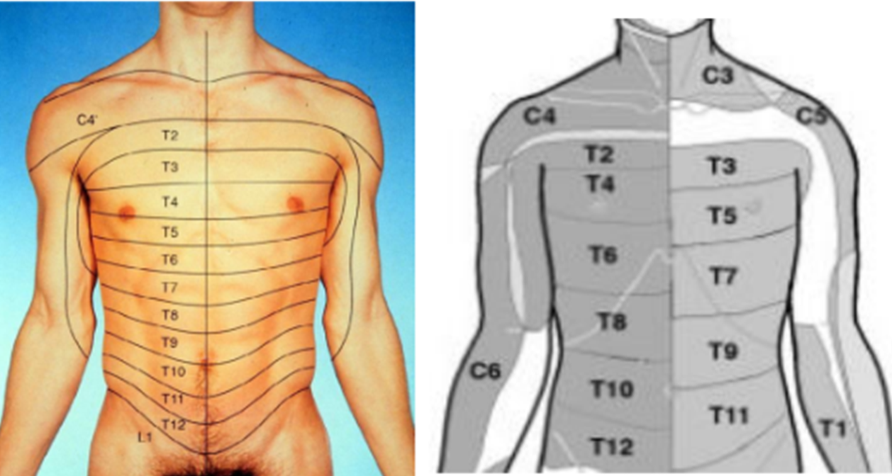
Dermatome
Dermatome
An area of skin supplied by a single nerve root
Intercostal nerves supply a dermatome
Dermatomes over chest wall overlap
Half by nerve above and below
Anterior rami
- Supplies skin & parietal pleura

Slide 36
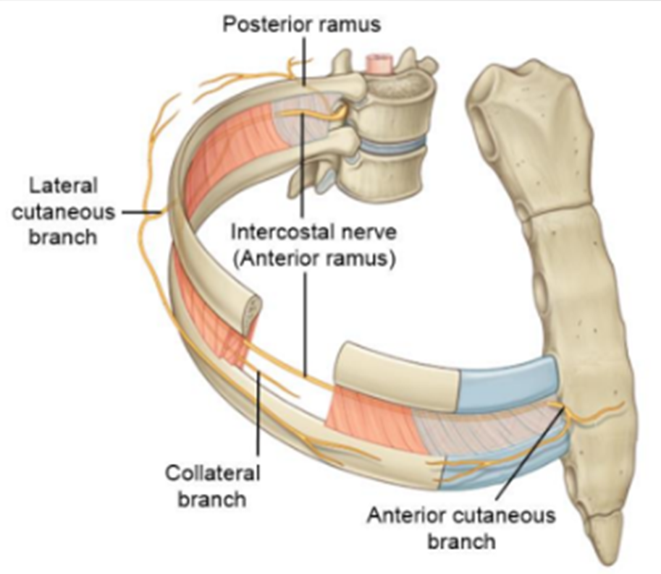
Innervation of the chest wall
Anterior rami, of thoracic spinal nerves supply
intercostal spaces ( intercostal muscles)
Associated skin
Serrous membrane ( inside of parietal pleura)
Posterior rami supply
post vertebral muscles
overlying skin
Thoracocentesis (pleural Tap) or nerve block
Middle of space safest
Nerve block: Rib above and below target nerve

Slide 37
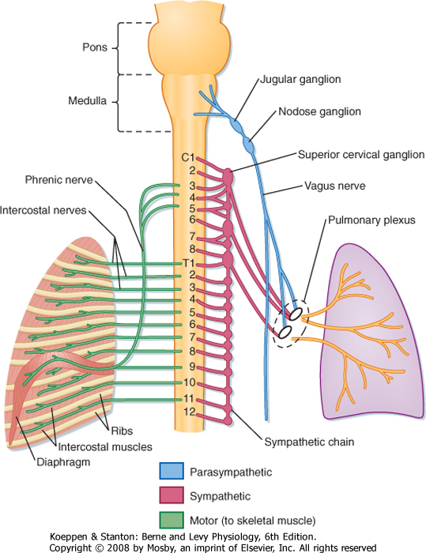
Innervation of the chest wall
Mechano-receptors in the chest wall and within the respiratory muscles have an effect in our sensation of dyspnoea and so part of our sensation of breathlessness is carried via the afferent fibres of the spinal cord.

Slide 38
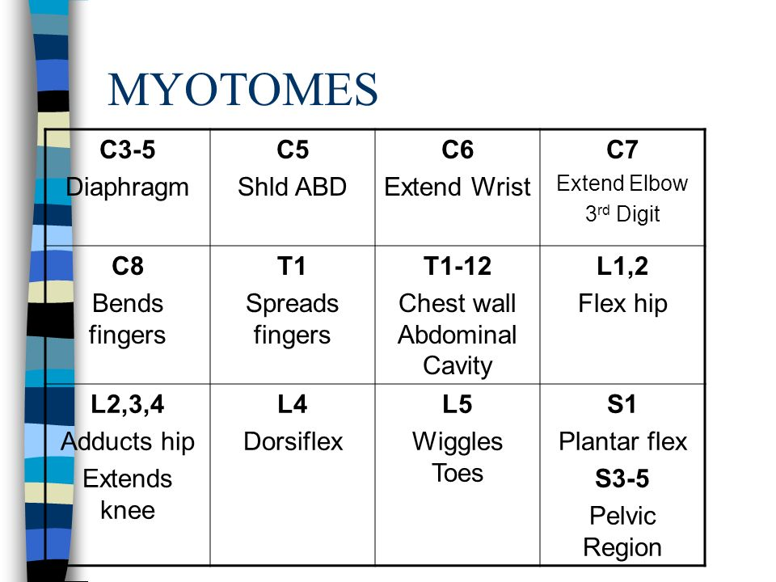
Innervation of chest wall
Schematic representation of afferent pathways of dyspnea from vagal receptors and peripheral chemoreceptors to the CNS. The precise pathways from the nucleus tractus solitarius to the limbic system and cortex are not clearly delineated and, hence, are shown as broken lines. RAR = rapidly adapting receptor; SAR = slowly adapting receptor.
Motor stimulation:
The motor control of our breathing is via the phrenic nerve that innervates the diaphragm. This comes from C3, C4 and C5.
The intercostal muscles are
Innervated by the intercostal
Nerves.

Slide 39
The lymphatic system
The Lymphatic System
Series of vessels and nodes
Superficial and deep drainage
Infections and cancer can spread via system
Vital part of the body’s immune defence / response to infection
collect and filter excess tissue fluid (lymph)
Filters blood from foreign particles
Returns blood it to the venous circulation.

Slide 40

The lymphatic system
Superficial:
Posterior chest wall: Drain to axillary lymph nodes
Anterior chest wall: axillary nodes (laterally) and Parasternal ( medially)

Slide 41

Deep lymphatic system
Drain mostly via the Bronchmediastinal lymph trunk and Thoracic duct
Viscera drained by posterior mediastinal, brachiocephalic or tracheobronchial ( all converge into bronchomediastinal lymph trunk)

Slide 42


Vasculature to the chest wall

Slide 43

The physiology of breathing

Slide 44
Physiology of breathing
Sensation from sensory nerve endings triggers the respiratory centre
Respiratory centres then trigger the breath
Motor response leads to the contraction of the diaphragm and intercostal muscles via the phrenic and intercostal nerves
Triggering of sensory nerves to stop the contraction of the diaphragm and intercostal muscles.
Relaxation of the diaphragm and intercostal muscles leads to the natural recoil of the lungs.

Slide 45

The physiology of breathing
It’s all about pressure!!!
Facilitated by:
  Contraction of respiratory muscles
  Movement of the ribs
  Movement of the diaphragm
  A concentration gradient
There are two types of breathing:
  Normal Quiet or Tidal breathing
  Forced breathing (e.g. breathing during exercise)

Slide 46

Physiology of breathing : Movement of the ribs
Two types of movement at rest or during quiet/tidal breathing:
Bucket handle :
  Primarily involves the upper ribs (1-6)
  The ribs move upward and outward
  This motion increases the anterior-posterior diameter of the thorax
Pump Handle :
  Mainly involves the lower ribs (7-10)
  The ribs rotate and move laterally outward
  This motion increases the transverse diameter of the thorax

Slide 47
Quiet / Tidal breathing : Inhalation
Contraction of the external intercostals and the diaphragm
Increased volume in the chest
Ribs move up and out
Diaphragm flattens and moves down
Decreases the pressure in the thorax ( intrathoracic pressure)
Air sucked in
Air moves down a pressure gradient from high ( atmospheric pressure) to low

Slide 48
Quiet / Tidal breathing : Expiration
Relaxation of the diaphragm and external intercostals
Decreased volume in the chest
Ribs move down and in
Diaphragm domes and moves up
Increases the pressure in the thorax (intrathoracic pressure)
Air pushed out
Air moves down a pressure gradient from high to low
Lung fibres recoil

Slide 49
Breathing under stress or forced expiration
Uses the abdominal muscles
Contraction of the internal intercoastal muscles

Slide 50
Main takeaways
Breathing in is an active but unconscious process
Air moves in and out of the lungs down a pressure gradient
Breathing out is passive at rest
Main muscles of respiration are:
  Diaphragm
  Intercostal muscles

